Slide 1

Advanced Business Analytics Final Project Forecasting Customer Returns
Section 3 Team 9
Abhishek Nambiar
Aditya Uppuluri
Lavanya Karthikeyan
Madhulika Chilla
Mandeep Singh Rahi
Tanveer Singh Sapra

Slide 2
Steps followed
Business Problem
Explore
Model
Recommendations

Slide 3
Defining the business problem
Steady increase in sales and profits for the business
But, returned value crossing more than 10% of sales value in 2017
Puts future sales planning at risk
Expected to increase in the future with eCommerce

Slide 4

Other than losing almost 10% of revenue, additional costs are incurred on customer returns
Cost of receiving return from customer, storage, processing for resale or disposal
Inbound Processing
Cost of processing “free” replacement order, return to vendor
Outbound Processing
Lost CAC and Gross Margins on the returned order
Lost Profits
Cost of Customer Returns
Potential loss of customers and reduced Lifetime Value
Customer Confidence
Customer Service Costs
Cost of return correspondence, additional labor costs
Environmental Costs
If product must be disposed (industry average: 10% of all returns)

Slide 5


Dataset description and aggregation
Order Data
Returns Data
Collection of sales orders with relevant features
Join collection of returned sales orders
Calculate
Aggregate
% return rate and returned value
At monthly level granularity

Slide 6
Exploratory data analysis
Analysis of Shipping Modes
Business Overview
Returns Overview
Impact of Returns on Regions and Categories
Impact of Delivery Duration on Profits
Impact of Delivery Duration on Returns

Slide 7
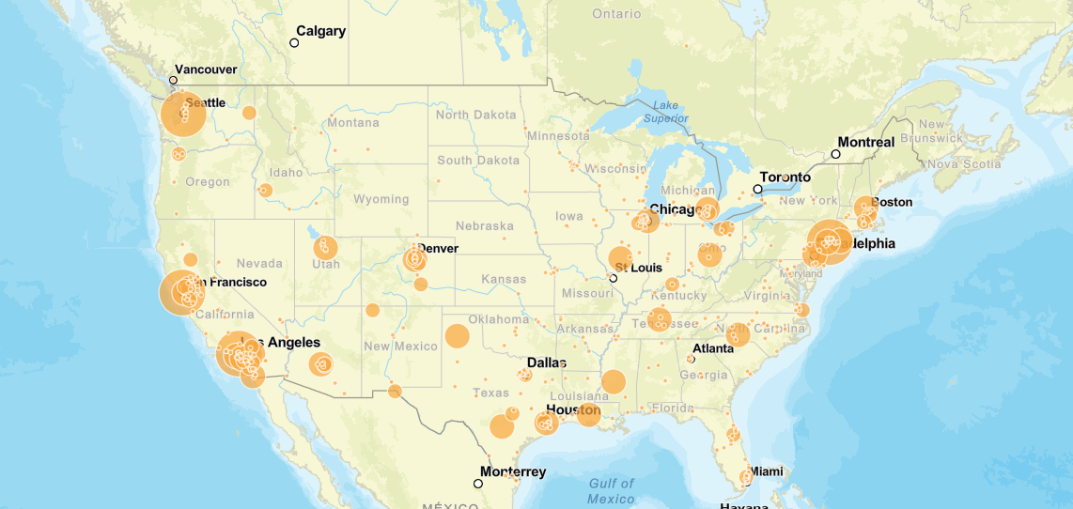
Business overview
55%+ discount
Average sales were highest when discount offered was greater than 55%
531 cities
These cities were the main hubs of customers ordering products
28% profit
About 700 customers contribute to over 28% profit in sales through purchases

Slide 8
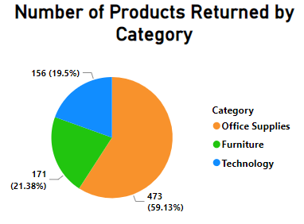
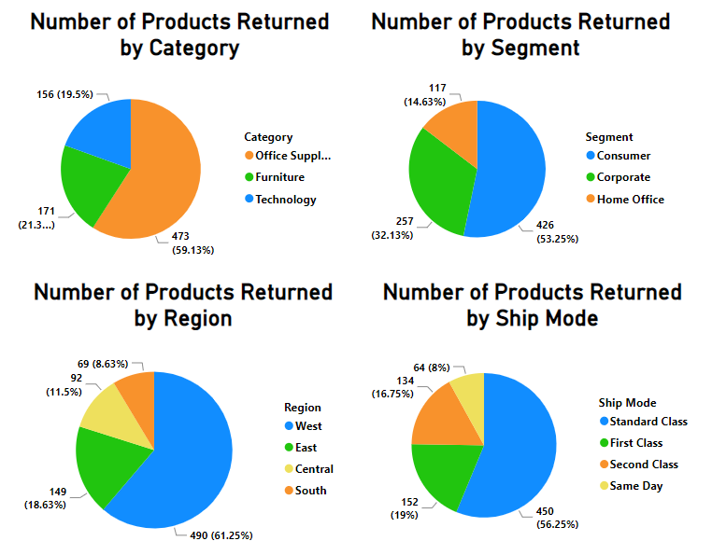
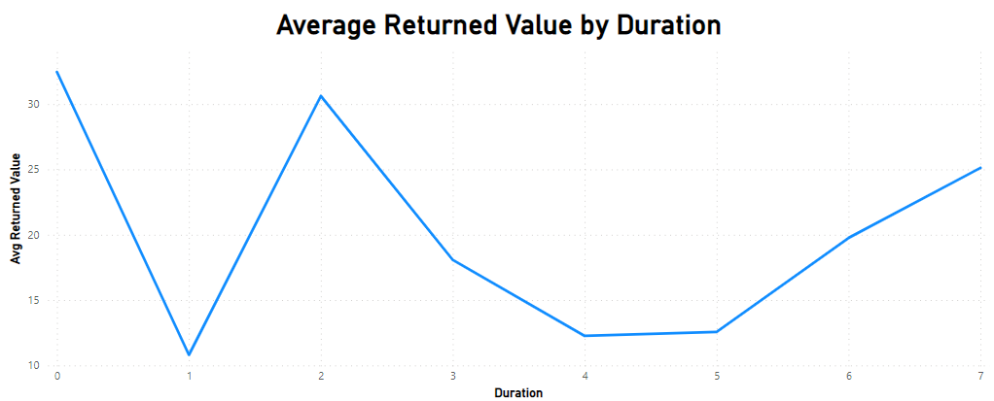
Returns overview
Delivery duration

Slide 9
Returns rate varying by region and category
4%
5%
4%
15%
West has more than 3x the average returns rate of other regions.
Region
Central
East
South
West
Furniture 8.1%
Technology, responsible for 51% of total profits, has the highest returns rate among categories.
Category
Office Supplies. 7.9%
Technology 8.5%

Slide 10
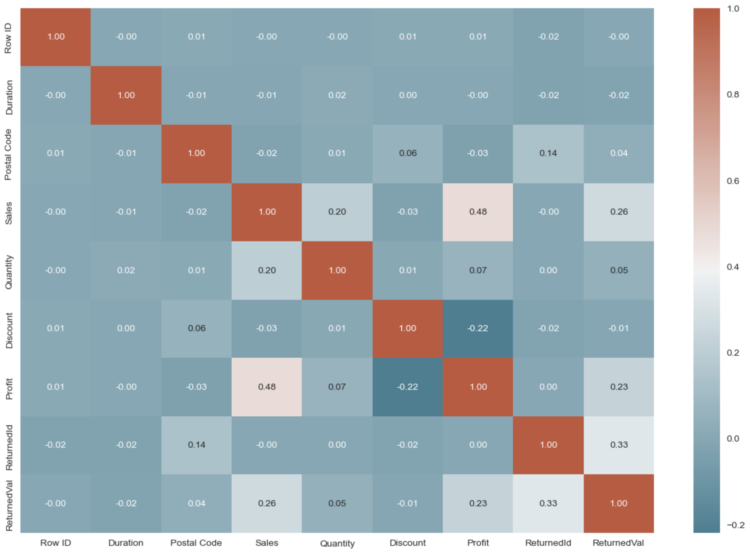
No significant correlation found
(>= 0.5 or <= -0.5)

Slide 11
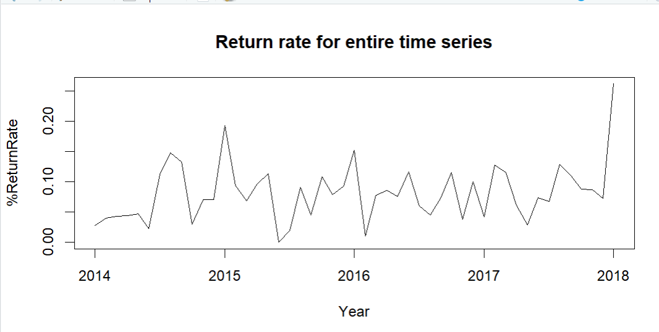
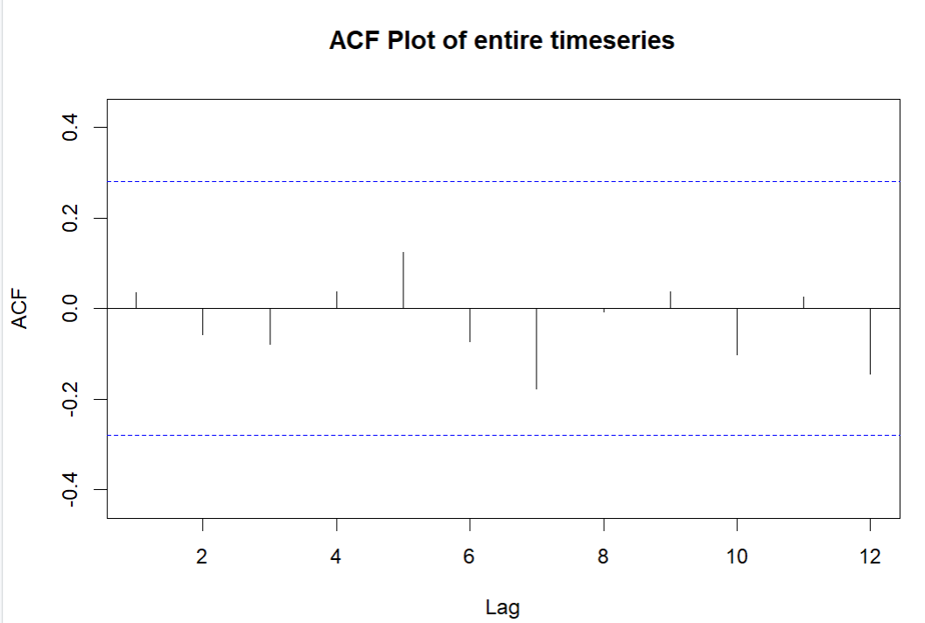
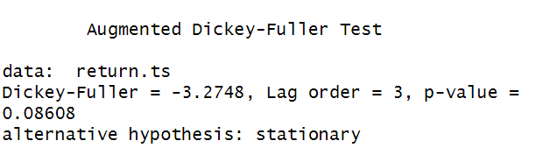
Non-stationary time series observed
No significant ACF observed
Non-Stationary

Slide 12
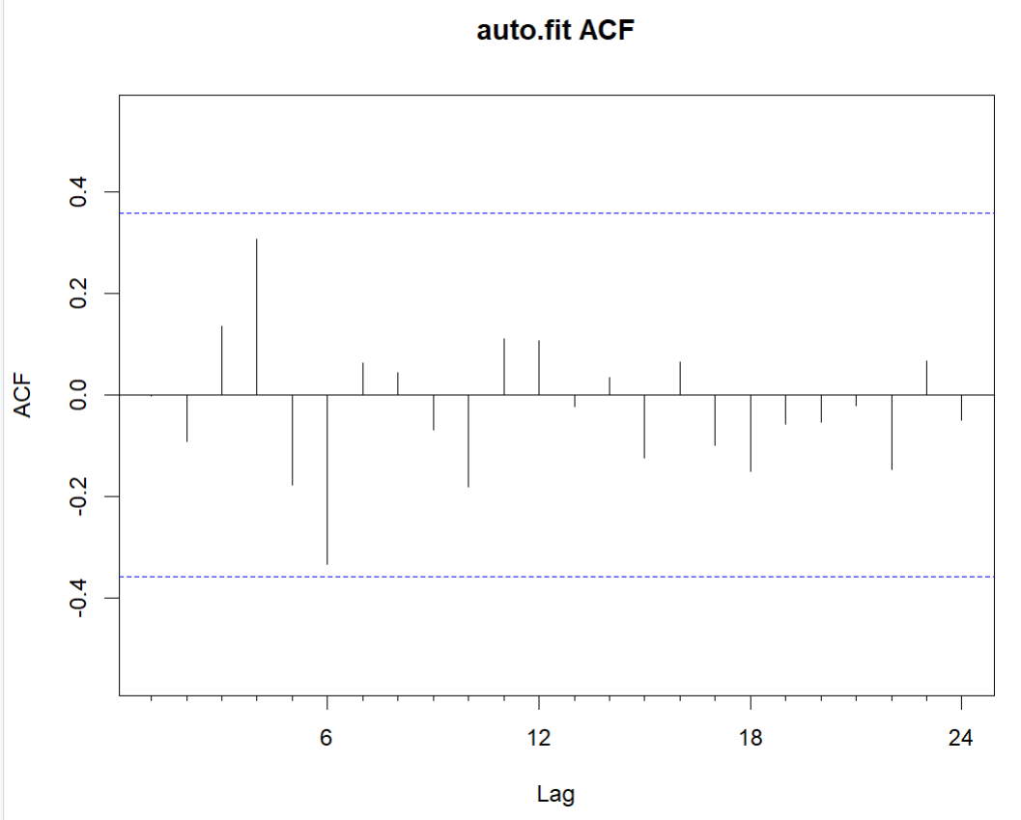
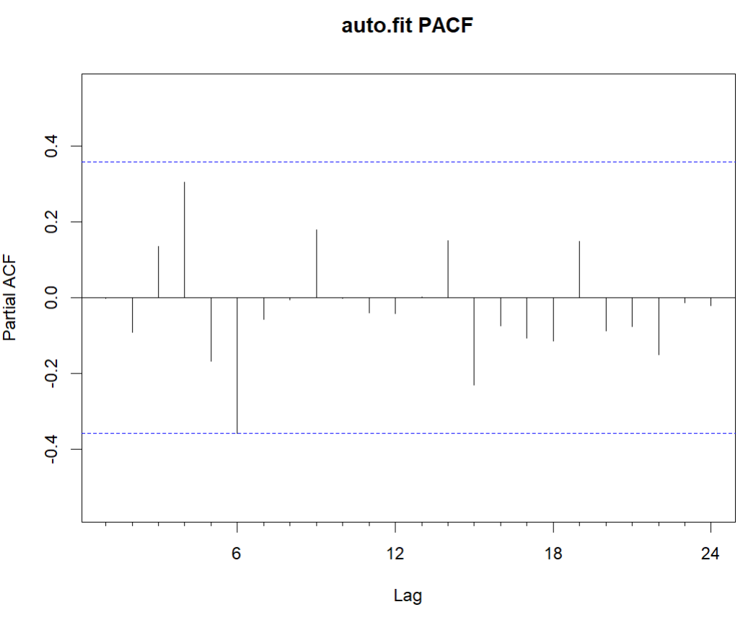
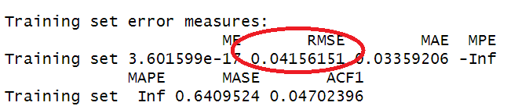
Auto Arima
No significant autocorrelation factor observed

Slide 13
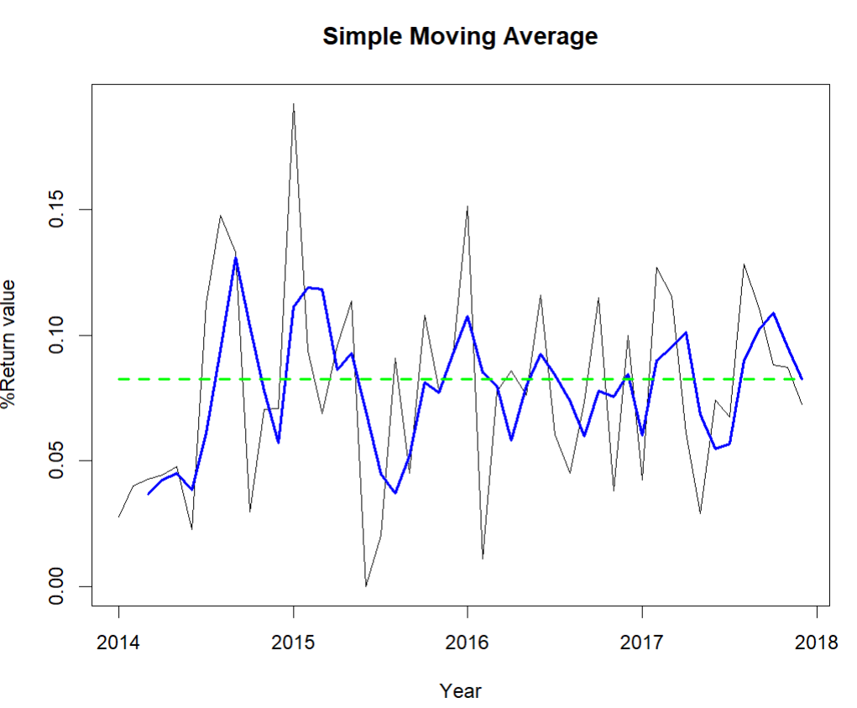
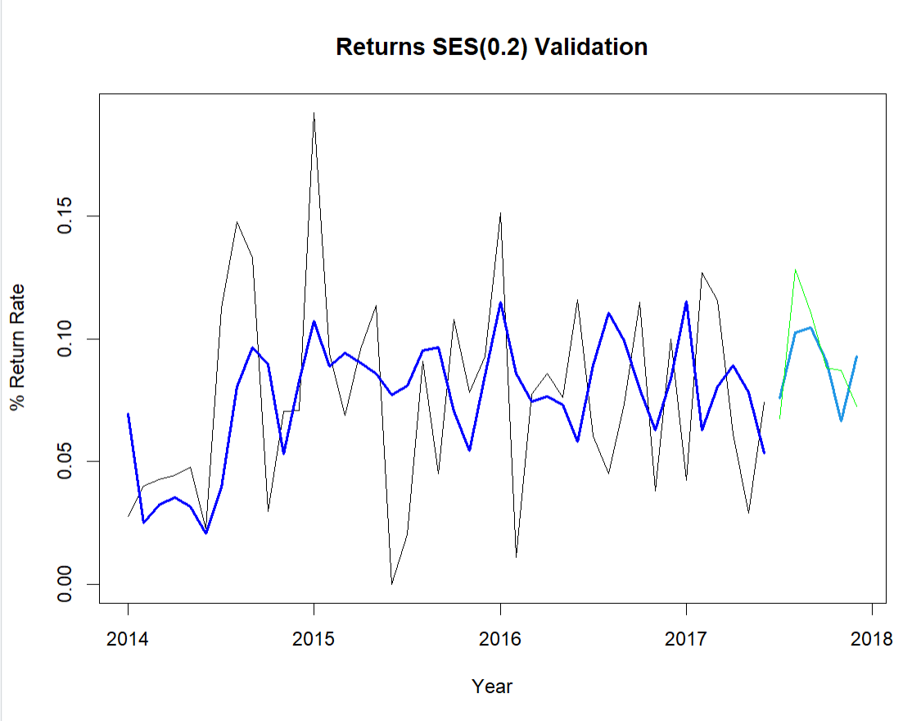
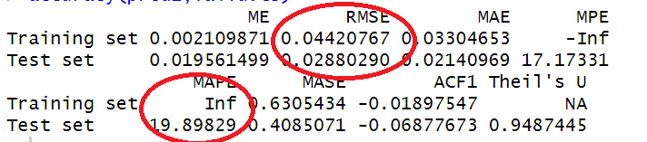
Moving on to smoothing models
Models not giving best results

Slide 14
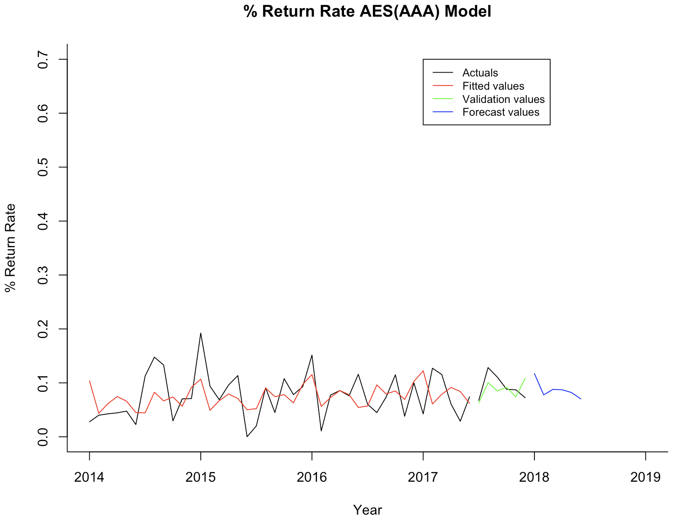
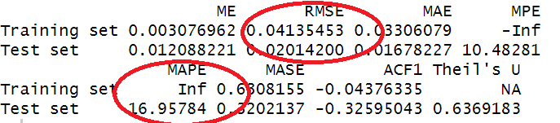
Finalized on Holt-Winters’ method
Month-Year | Forecasted values
Jan-2018 | 0.1172
Feb-2018 | 0.0777
Mar-2018 | 0.0879
Apr-2018 | 0.0871
May-2018 | 0.0820
June-2018 | 0.0703

Slide 15
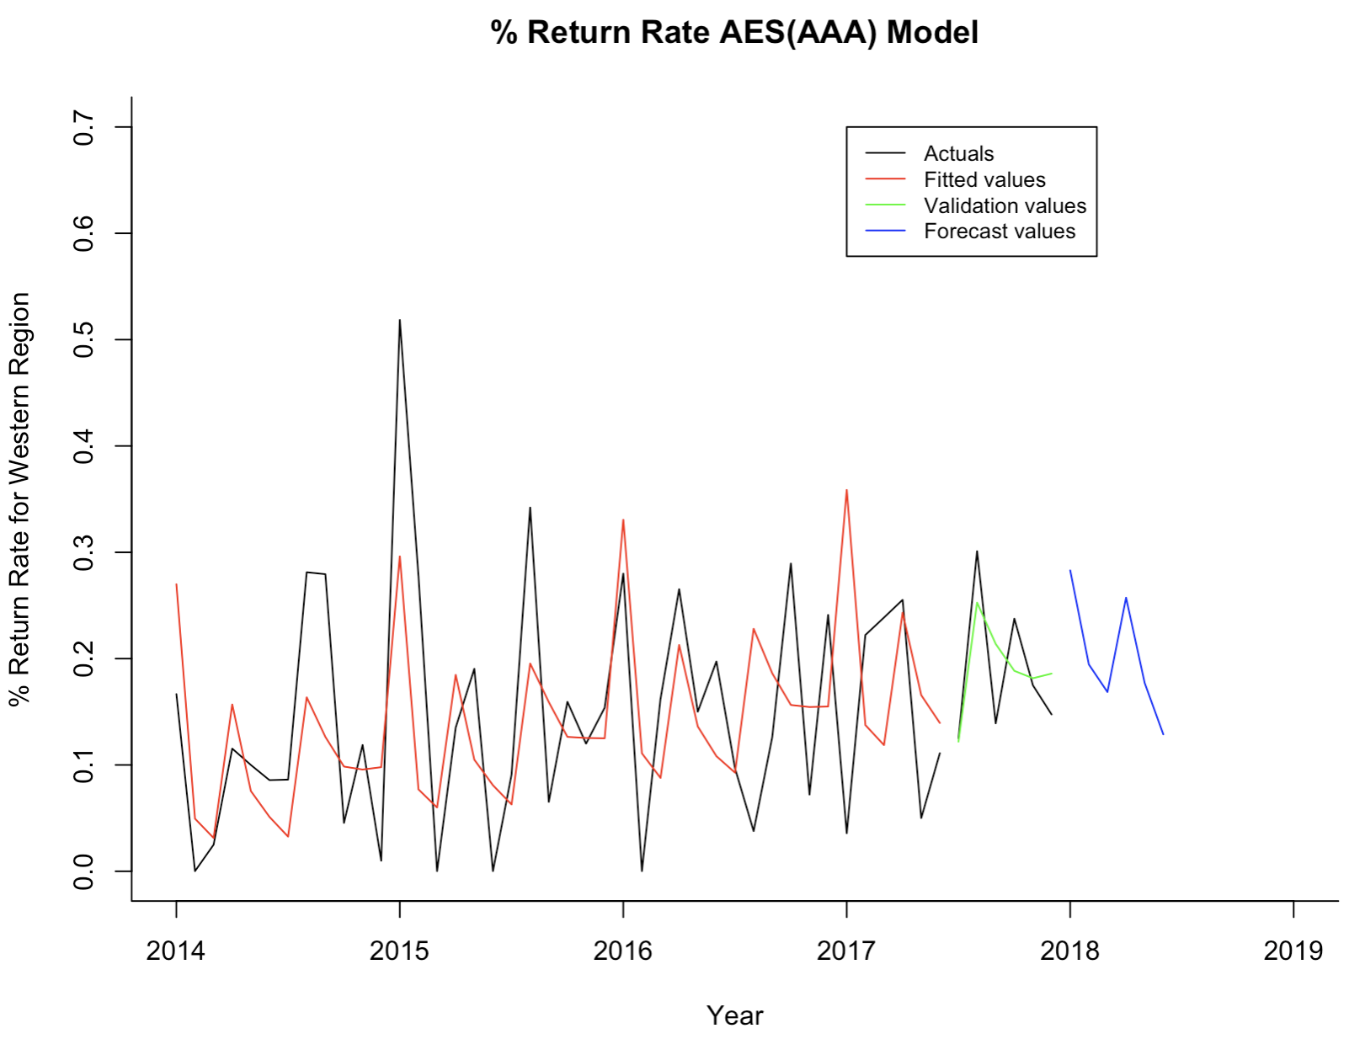
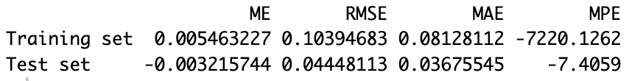
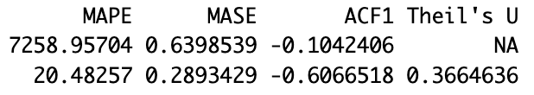
Particularly forecasting for West region
Month-Year | Forecasted values
Jan-2018 | 0.2930
Feb-2018 | 0.1980
Mar-2018 | 0.1727
Apr-2018 | 0.2567
May-2018 | 0.1797
June-2018 | 0.1223

Slide 16
Recommendations
Focus on West region to forecast and reduce return rate
Monitor category-wise and city-wise return rates
Collect additional returns data to improve forecasting
Adopt multivariate time series forecasting in the future

Slide 17
Thank you!

